Slide 1

28.03.2026
Sales and Stock Analysis
Bright Coffee Shop
By Thandeka Ngetu
Junior Data Analyst

Slide 2
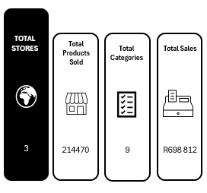
Over the past 6 month across our 3 stores, we’ve sold over 214 000 SKUs across 9 catergories, generating close to R700 000 in sales.

Slide 3
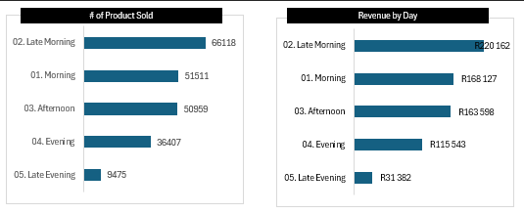
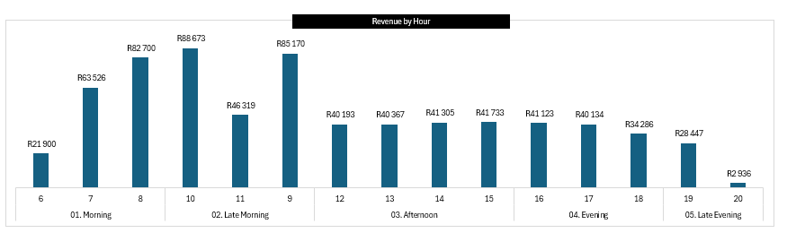
Customer Activity Trends by Time of Day
Late mornings are our strongest trading period in terms of both sales volume and revenue, while late evenings show a significant drop, indicating lower customer activity later in the day.

Slide 4
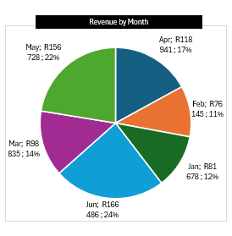
Revenue Performance vs Seasonal Ptterns
This seasonal trend indicates an opportunity to strategically promote warm berverages and bundles during colder months while introducing refreshing or lighter options during summer to balance performance

Slide 5
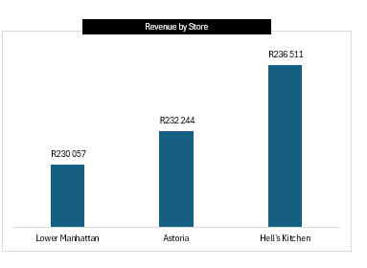
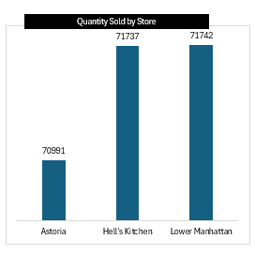
Revenue & Sales Performance by Store
All three stores have similar sales volumes, Astoria generates higher revenue, indicating higer-value pircing.
Hell’s Kitchen and Lower Manhattan sell slightly more units than Astoria but generate less revenue. This suggests an oppotunity to improve pricing strategies, upselling or product mix in these locations

Slide 6
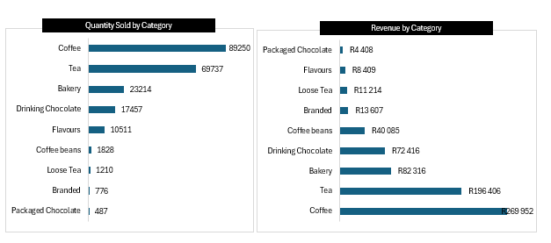
What Customers Buy Most vs What Generates the Most Revenue
This shows the importance of balancing high-volume products like coffee with high-value items like coffee beans to mazimize overall revenue.

Slide 7
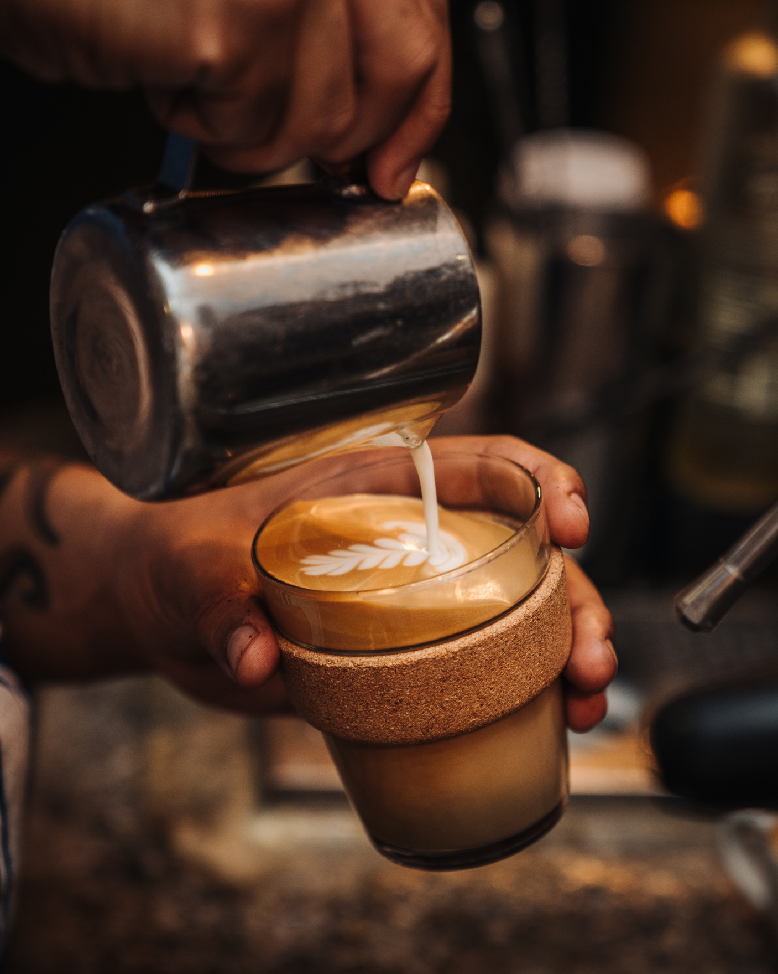
Marketing Campaigns for Slow Time Slots (Late Evening
Happy Hour discounts (buy 1 get 1 free after 18:00)
Combo deals (Coffee + bakery at a reduced price
Loyalty rewards (double points during slow hours)
Student or after work specials

Slide 8

Stock More of Best-Selling Items
Increase stock avsilability diring peak times (morning and late mornings
Avoid stockouts of high-demand items
Prioritize fast-moving products in inventory

Slide 9
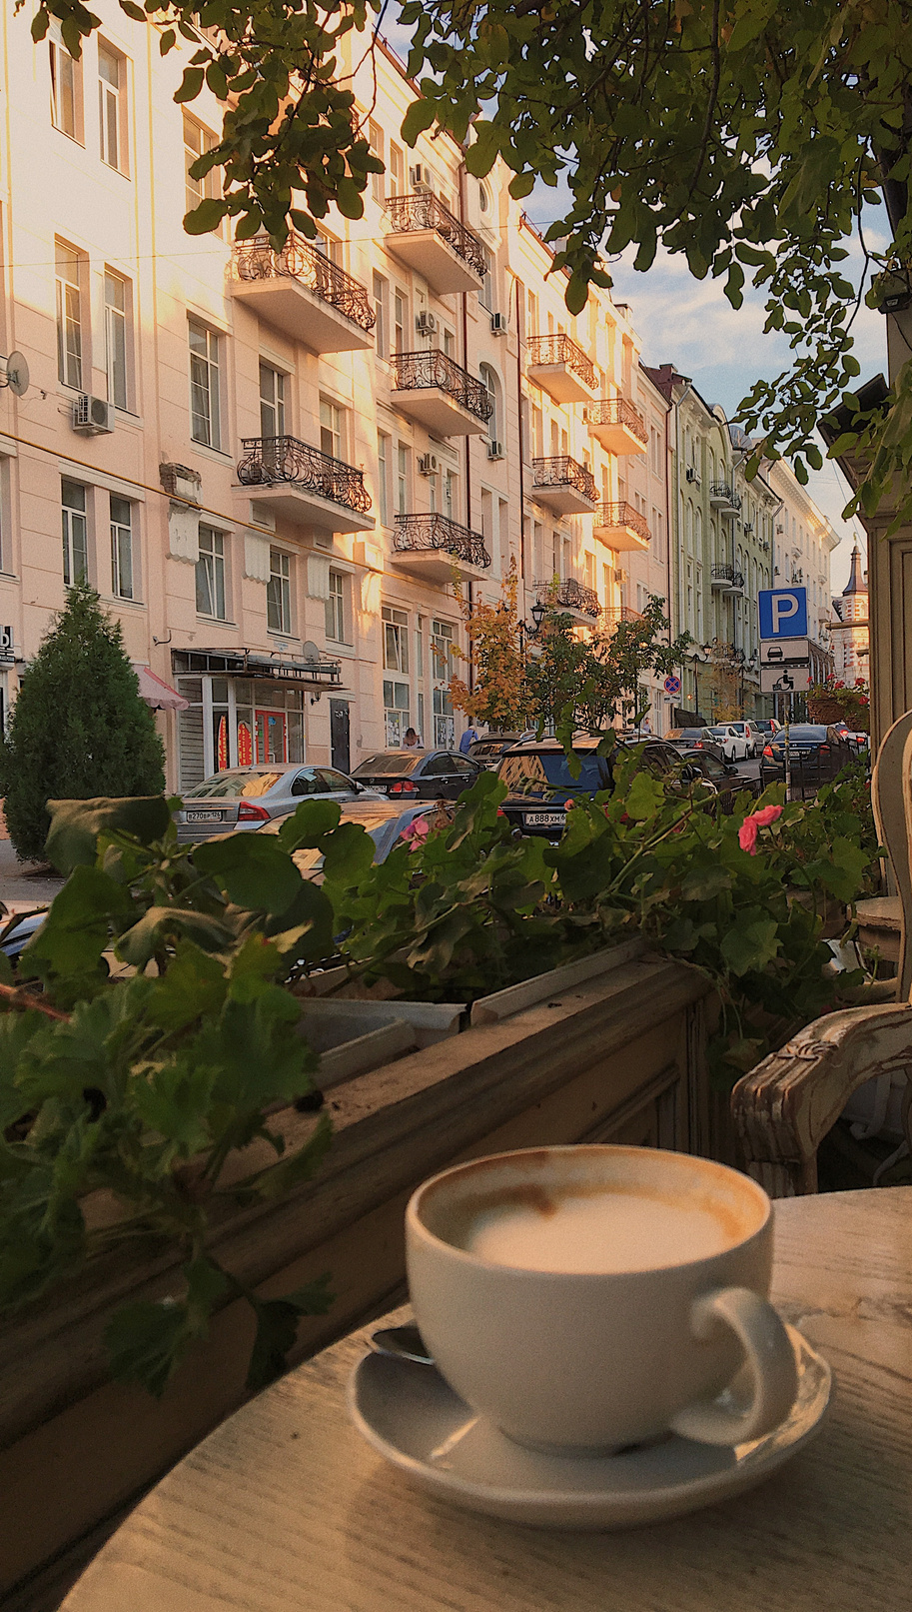

Promote Underperming Products
Use upselling
Improve in-store visibility
Bundle with popular items
Offer limited discounts

Slide 10

End of Presentation
Thank You
Thandeka Ngetu
Bright Coffee Shops
079 5807538
ngetu.thandeka09@gmail.com

